Slide 1
Global History: year # 2
Sample

Slide 2
The invention of the Printing Press
Another important change that came about during the 1400’s is the invention of the printing press by the German inventor Johan Gutenberg in the 1400s.
The printing press revolutionized the world by making books more readily available and cheaper, which led to an increased literacy (the ability to read) among the populace of Europe.

Slide 3
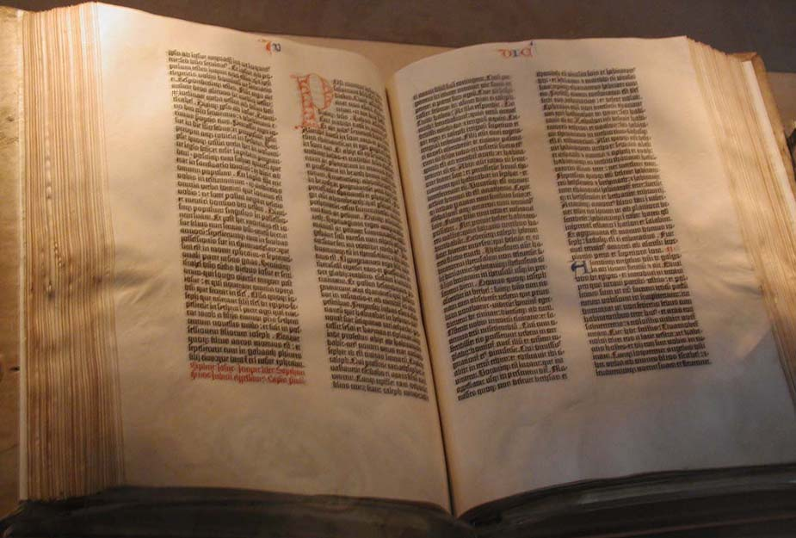
The Gutenberg Bible, the first book printed by Johannes Guttenberg. This edition can be found in the Library of Congress, Washington, D.C.
Notes:
By Raul654, CC BY-SA 3.0, https://commons.wikimedia.org/w/index.php?curid=36892

Slide 4
The effect of the printing press on Judaism
The effects were many, and mostly positive. Before the invention of the printing press, seforim were hand written manuscripts and thus quite limited.
It was a painstakingly long drawn-out process to write a sefer and copy it. Thus seforim were very rare and very hard to come by.
After the invention of the priniting press, seforim were much more available than they once were making them more accessible and cheaper.
This historical event began a process of general enlightenment and could be seen as a major step in preparing for the arrival of Moshiach as Torah knowledge has increased due to it.
Notes:
We should include the Goyim’s angle here as well. The increase in knowledge itself is I believe an important step in the coming of moshiach. That is I believe that the more knowledge there is the greater technology is. And that enhances the world to be a better physical place which means that the world is slowly revolving towards physical perfection from the goyim’s point of view and the Jew’s perfecting their mission by becoming more knowledgeable from a Torah perspective.
Also it will eventually provide for us a challenge not to read bad books that turn people off from yiddishkiet.

Slide 5
The introduction of perakim into the Torah
Before the invention of the printing press, the Torah was divided by parshiyos, setumos and pesukos.
However a non-Jewish printer by the name of Daniel Bromberg, a printer in the early days of printing, printed a Torah and added his own perakim and pesukim numbers to the perakim.
We still keep that system today, not because it has any kedusha but simply because if we were to try and remove it or change it, it would create a great amount of chaos in trying to find anything in the Torah.

Slide 6
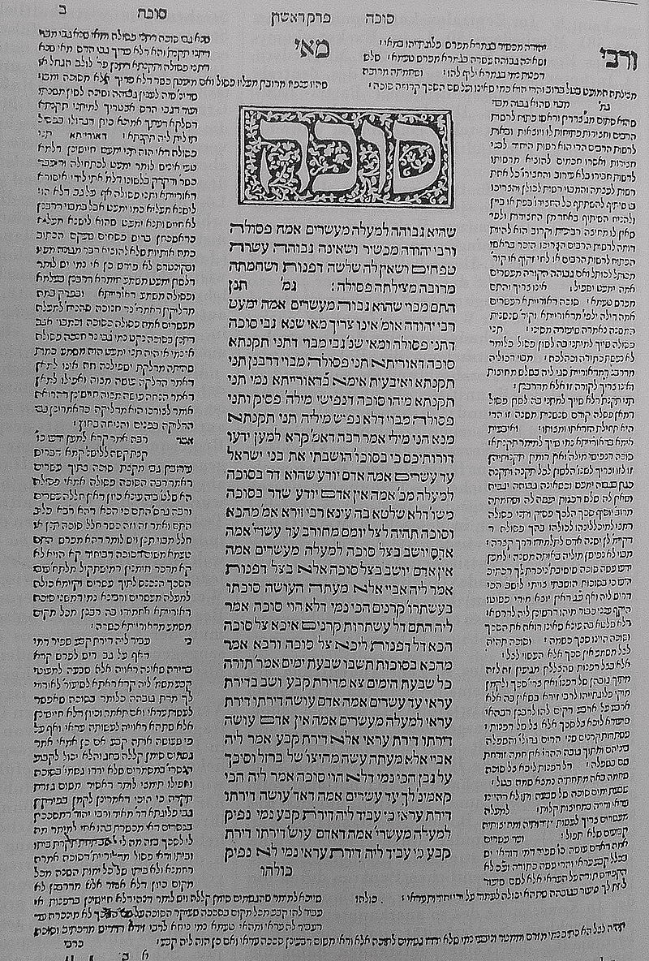
An early edition of the Talmud 2d edition; printed by Daniel Bomberg, in Venice.

Slide 7
The printing press also brought about a famous controversy regarding halacha and intellectual property
Additionally a big turmoil came about because of the invention of the printing press.
The Mahara”m Mipadua, a gadol during that period, banned anyone from using a certain printing of the Ramba”m with his glosses on the side that was printed without his permission.
The Mahar”m wrote a famous letter to the Ram”a who lived at the time asking him to put the sefer in Cherem since it was hasagas gevul.
This case has been used by many future poskim when deciding on cases of intellectual property rights.

Slide 8
The invention of the printing press also provided much halachic discussion regarding the kedusha of the printed sefer.
Ever since the printing press was invented, Poskim have had to grapple with the halachic status of the printed word. (See the Pischai teshuva in Hilchos sefer Torah (271:20) and the MB (40:3) who discuss this topic and the pischai Teshuva in even ezer regarding about a get typed out if it is good.)
There are opinions that hold that that seforim that are published do not have kedushas seforim!
The general accepted approach is that while it doesn’t in some cases rise to the same kedusha as a sefer Torah, the printed word has some degree of keduash and one may not use it or dispose of it in a degrading manner.
Notes:
Rav belsky said over the bishem the Magen Avraham that the reason why people are not yotzai with someone else’s bentching (as it says in the gemara) is due to the printing press. That is, being that people now have many more seforim and more people know the text, therefore we all bentch ourselves! Rav belsky concluded that we see how the printing press is important for it changed the halacha!

