Slide 1
Ancient India
A Torah perspective

Slide 2
India on the Globe

Slide 3
The natural geography of India. Note the Deccan plateau and the Himalayas mountain range in the North

Slide 4
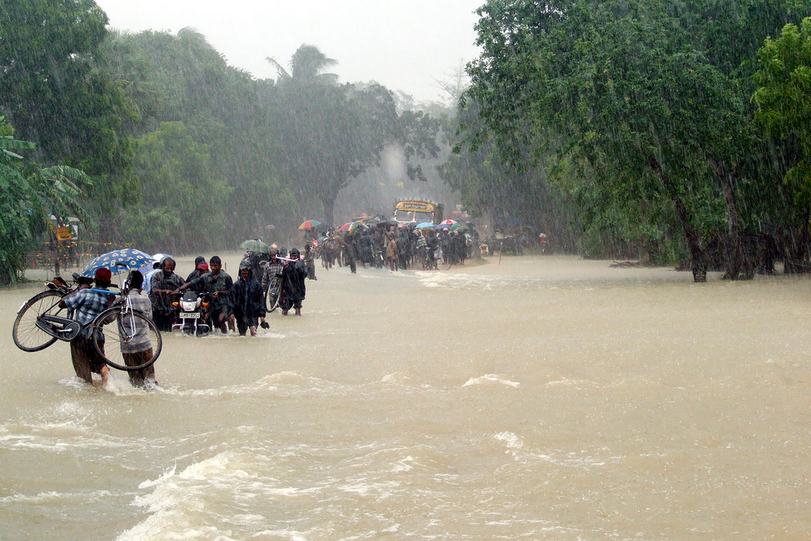
Monsoons
Due to its geography, every year, temperature gradients bring summer rains to India which inundate the Indian subcontinent. Sometimes these rains cause widespread flooding as seen in this picture

Slide 5
Ancient Indian history
Indian history and culture is very much tied together with its religion: Hinduism.
The Halacha tells us that one may not learn about other religions.
However some Poskim rule that under certain very modified conditions, one may acquaint oneself with certain terms associated with other religions.
For those yeshivos that will be following this approach, let’s take a look at the booklet approved by Rav Belsky zatza”l to acquaint oneself with these terms.
For those that won’t, we move on to some Jewish sources regarding ancient India

Slide 6
Jewish sources on the source of Indians
The Ibn Ezra in Shemos (perek 19:9 in his long pirush) says that the Indians come from Cham. He writes that they where closely related to the Egyptians and they followed the same kind of religious and cultural practices such as hating Shepherds since cattle are holy to them.
The Abarbanel (Biraishis 4:9( says
ובספר הרומיים כתוב שהלך קין בארץ הודו ואולי שלכך נקרא הודו מלשון נדוד (that after he was cursed, Kayin went to India and he suggests that therefore India is called Hodu since it’s a play on words with Na vinud!)
If that is the case, it would suggest that he was the founder of the Indus river valley civilization since the Torah tells us he was a boinai Ir!
Notes:
Its also no contraditcion with the above mentioned Ibn Ezra since the current culture of India was a new Arayn culture that formed only in the last 4000 years.

Slide 7
Torah connections with India: a River mentioned in the Torah, Achshverosh’s rule, clothing worn by the Kohain Gadol and a type of bread eaten in the times of Chaza”l
תרגום יונתן בראשית פרשת בראשית פרק ב פסוק יא שׁוּם חַד פִּישׁוֹן הוּא דְמַקִיף יַת כָּל אֲרַע הִינְדִקֵי דְתַמָן דַהֲבָא
משנה מסכת יומא פרק ג משנה ז בשחר היה לובש פלוסין של שנים עשר מנה ובין הערבים הנדוין של שמונה מאות זוז
ר' עובדיה מברטנורא מסכת יומא פרק ג משנה ז הנדואין - מארץ הודו:
תוספות יום טוב מסכת יומא פרק ג משנה ז שוב מצאתי בתרגום אסתר מהודו ועד כוש. מן הינדיא רבא ועד כוש. וזה כדברי הר"ב:
רש"ש מסכת ברכות דף לז עמוד ב נהמא דהנדקא. נראה פי' לחם שעושין בארץ הודו עי' ערוך ערך הנדיקי )מהודו ועד כוש תרגום מהינדקי עד כוש)

Slide 8
Maurya Empire.

Slide 9
Maurya Empire: 321 BC–185 BC
Founded by Chandragupta Maurya
Achievements: built large, wealthy cities with libraries, parks, splendid palaces, and temples.
Most famous leader was Asoka, Chandragupta’s grandson,
At first, Asoka was a ruthless killer but later on, turned his life around and became noble ruler and brought economic prosperity to his kingdom.

Slide 10
Gupta empire 320 CE—500 AD
Achievements:
Set up hospitals for the poor,
amassed wealth,
engaged in trade and farming,
had large universities where Buddhism and Hinduism were studied along with secular subjects,
Saw the invention of numbers and decimals which are still used today,
pioneered plastic surgery and vaccination against smallpox,
made huge stupas (temples),
and produced many works of fictional literature.
Eventually it run over by the Huns from central Asia around 500 AD

Slide 11
Gupta empire at its various stages

Slide 12
attribution
By Ssolbergj (talk) - Own work,This vector image was created with Inkscape.Aquarius.geomar.de https://commons.wikimedia.org/w/index.php?curid=5123101
By Nichalp - Own work, CC BY-SA 3.0, https://commons.wikimedia.org/w/index.php?curid=179162
By trokilinochchi - originally posted to Flickr as 152, CC BY 2.0, https://commons.wikimedia.org/w/index.php?curid=6692202
By Avantiputra7 - Own work, CC BY-SA 3.0, https://commons.wikimedia.org/w/index.php?curid=33726301
By Javierfv1212 - GIMP, CC BY-SA 3.0, https://commons.wikimedia.org/w/index.php?curid=40785465

