Slide 1
The National debt and deficit
A Torah based study

Slide 2
The difference between debt and deficit
Despite efforts made by the US government to keep a balanced budget, in most years, their efforts fail.
Most years, the spending by the federal government exceeds the incomes through taxes and other fees. This difference is called the deficit.
To pay for this extra debt, the US government borrows by issuing US savings bonds (basically a shtar chov) which people all over the world purchase and which they will eventually collect on with interest.
As these deficits continue to be had every year, and largely remain unpaid, this brings the US deeper and deeper into debt.

Slide 3
What causes these deficits to occur?
Deficits are accrued usually because of wars and recessions, although as of late, even without wars and recessions, regular spending seems to outpace income.
The precedent of spending more than what was coming in (at least on defense) was set in the revolutionary war when the colonies borrowed more than they had to buy weapons and feed their armies.
In the civil war, the US deficit ran up to 1 billion dollars. In WWII it ran up to 200 billion. In the 1980’s to 90’s, in order to fight the recession ongoing at the time, the US ran up trillions of dollars in debt by cutting taxes in order to stimulate the economy.

Slide 4
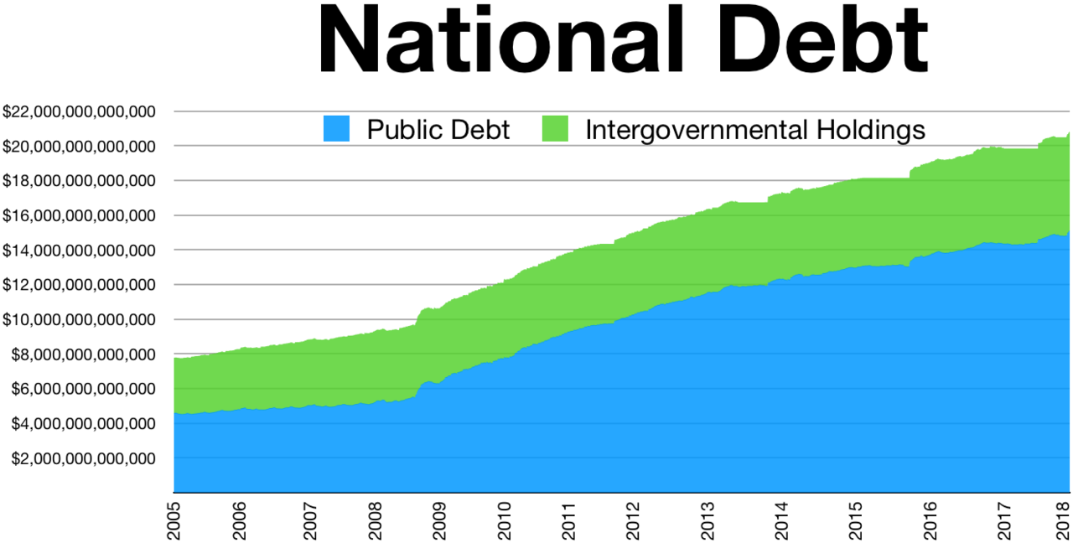
How big is the national debt today?
Notes:
Wikipedia public domain

Slide 5
Is this debt good or bad for the US?
It depends
On the one hand, it allows us the freedom to do what we wish today.
Also, as long as the economy keeps on growing and we are able to make the yearly payments on the interest, we are ok even with a growing debt.
However if times were no good over a long period and our revenue dropped significantly, we would be in no shape to pay our debt,
This would essentially bankrupt this country.
Moreover, if there was a panic in the world and all the people who owned American debt all came collecting at once, we would have no money for anything as the amount owed= or even exceeds the total GDP of the US economy!

Slide 6
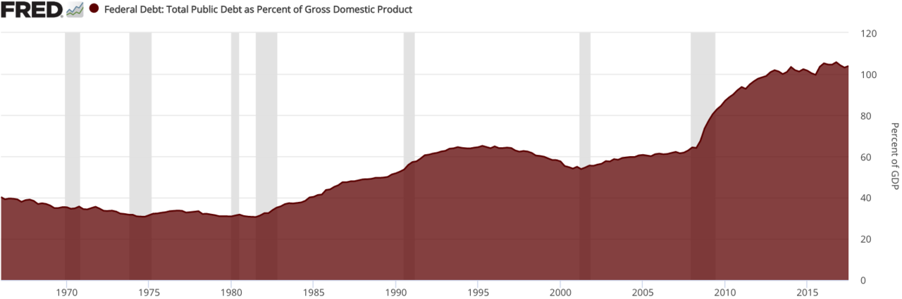
And how much is it of the GDP
Notes:
Wikipedia public domain

Slide 7
Internal vs. external debt
Much of debt that the US has, is owed to its citizens and other governmental agencies. Thus even if we have to pay it up to the citizens, that money will be used to buy items in the US and will recycle money back into the economy keeping the economy strong.
Moreover, that money will be taxed and thus it is similar to taking money from one pocket and putting it into another.
In a way this internal debt can almost be seen as a good debt.
On the other hand, 47% of US debt is owed to foreign governments and citizens of other countries. That debt could be seen as bad since one that money that leaves our country it wont benefit anyone here.

Slide 8
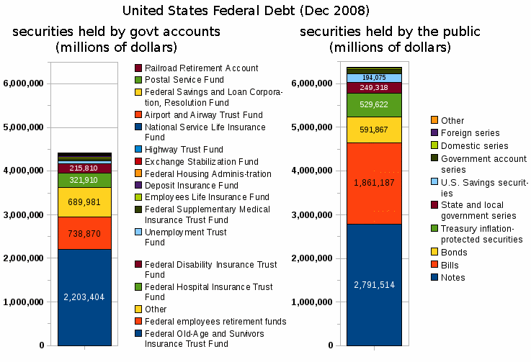

Slide 9
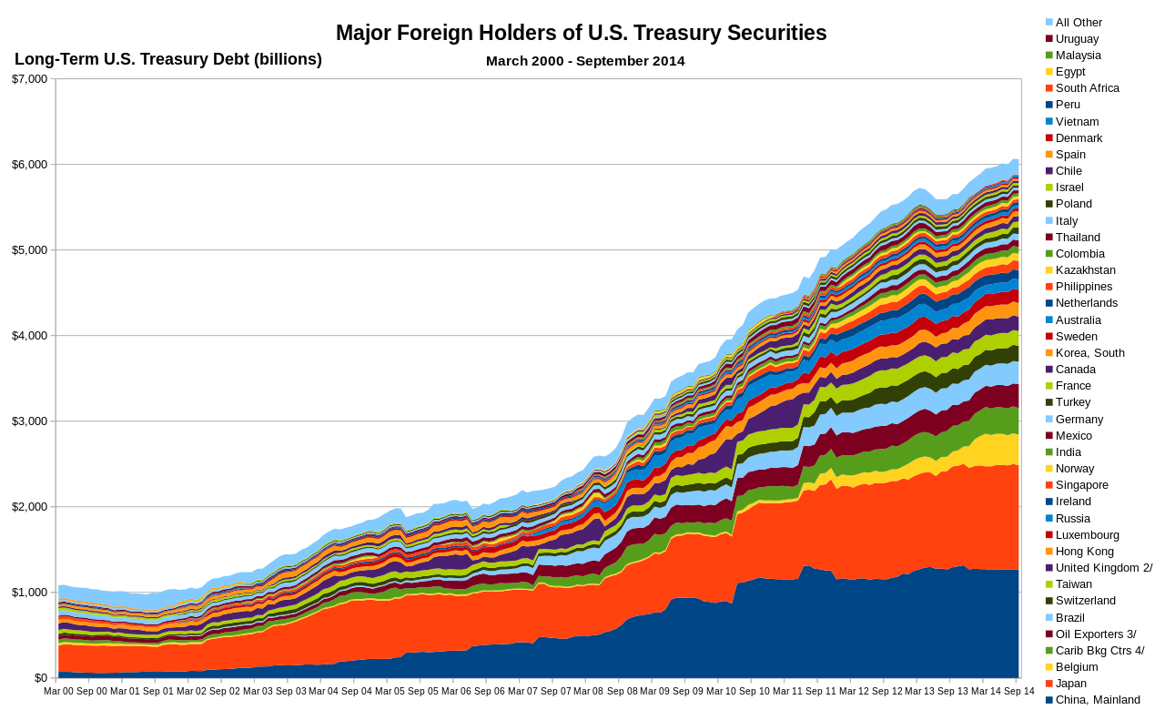
Notes:
By QDren - Own work, CC0, https://commons.wikimedia.org/w/index.php?curid=37055469

Slide 10
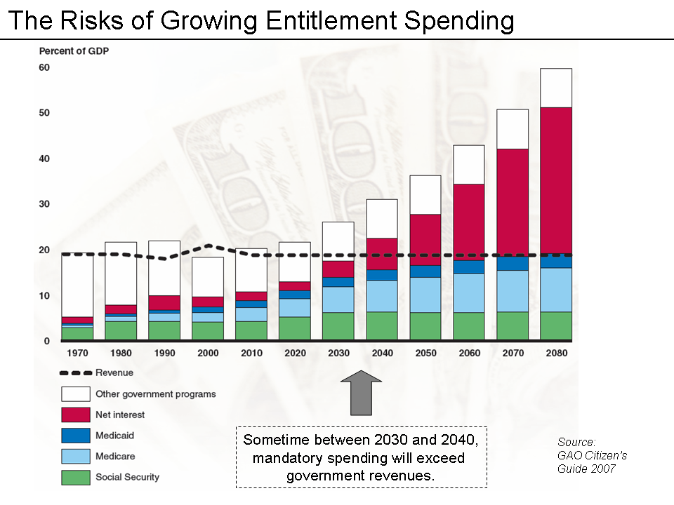
This chart however assumes that revenues will remain flat which historically ha not been true

